Slide 1
Python
pandas

Slide 2
Pandas – what we will learn
Purpose of Pandas
Types of data with Pandas
Loading CSV file using Pandas
Basic data verification
Summary stats
Scatter, Histogram plots ( Matplotlib)
Covariance, correlation
Sort

Slide 3
Python library
High-performance,
Easy-to-use data structures
Data analysis tools
Pandas is derived from the word Panel Data – an Econometrics from Multidimensional data.

Slide 4
In 2008, developer Wes McKinney started developing pandas when in need of high performance, flexible tool for analysis of data.
What’s cool about Pandas is that it takes data (like a CSV or TSV file, or a SQL database) and creates a Python object with rows and columns called data frame

Slide 5
Python 2.7 or 3.X+
Numpy
Scipy
Matplotlib – Plot

Slide 6
load,
prepare,
manipulate,
model,
analyze.

Slide 7
pip install pandas
Pip3 install pandas

Slide 8
Pandas deals with the following three data structures −
Series
DataFrame
Panel

Slide 9
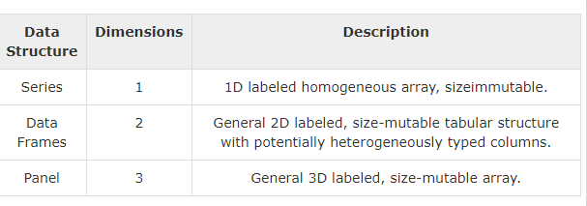

Slide 10
Code ..
import pandas as pd
import numpy as np

Slide 11
Pd.Series()
Pd.DataFrame()
pandas.Panel()

Slide 12
Inputs to Pandas
Convert a Python’s list, dictionary or Numpy array to a Pandas data frame
Open a local file using Pandas, usually a CSV file, but could also be a delimited text file (like TSV), Excel, etc
Open a remote file or database like a CSV or a JSONon a website through a URL or read from a SQL table/database

Slide 13
Read CSV
df = pd.read_csv('C:\\Users\\radha\\Desktop\\weka analysis\\wekadata1.csv')
print(type(df)) # Use the `shape` property print(df.shape) # Or use the `len()` function with the `index` property print(len(df.index))
# print(df.count())

Slide 14
print(df.count()) print(df.head()) print(df.loc[:5,'P_calories'])
print(df.iloc[:5,2])
print(df.loc[:5,['P_calories','U_cholesterol']])

Slide 15
print(df['P_calories'].describe())
Df.describe()
import sys df2 = df['P_calories'].describe() np.savetxt(sys.stdout, df2, '%16.8f')

Slide 16
pd.options.display.float_format = '{:,.2f}'.format
print(df2)
#############
import sys df2 = df['P_calories'].describe() df3 = np.savetxt(sys.stdout, df2, '%16.2f')

Slide 17
pandas.Series( data, index, dtype, copy)
#import the pandas library and aliasing as pd
import pandas as pd
import numpy as np
data = np.array(['a','b','c','d'])
s = pd.Series(data)
Print(s)
print(s[0])

Slide 18
print(s[:3])
Print(s['a'])

Slide 19
Data Frame
pandas.DataFrame( data, index, columns, dtype, copy)
Index - row labels
Column – column label
Dtype – data type
Copy – copying data.

Slide 20
df.loc['b'] – Selection by label
df.iloc[2] – Integer Location
df[2:4]

Slide 21
A panel is a 3D container of data. The term Panel data is derived from econometrics and is partially responsible for the name pandas − pan(el)-da(ta)-s.
pandas.Panel(data, items, major_axis, minor_axis, dtype, copy)

Slide 22
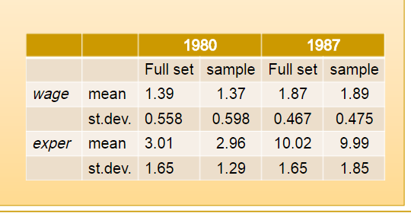
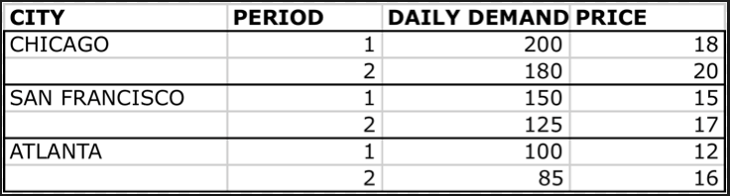
Panel

Slide 23
data = np.random.rand(2,4,5)
p = pd.Panel(data)
print(p)
<class 'pandas.core.panel.Panel'>
Dimensions: 2 (items) x 4 (major_axis) x 5 (minor_axis)
Items axis: 0 to 1
Major_axis axis: 0 to 3
Minor_axis axis: 0 to 4

Slide 24
print df.sum()
print df.sum(1)
Mean()
Std()
describe() - summary of statistics
print df.describe(include=['object'])
object − Summarizes String columns
number − Summarizes Numeric columns
all − Summarizes all columns together (Should not pass it as a list value)
df. describe(include='all')

Slide 25
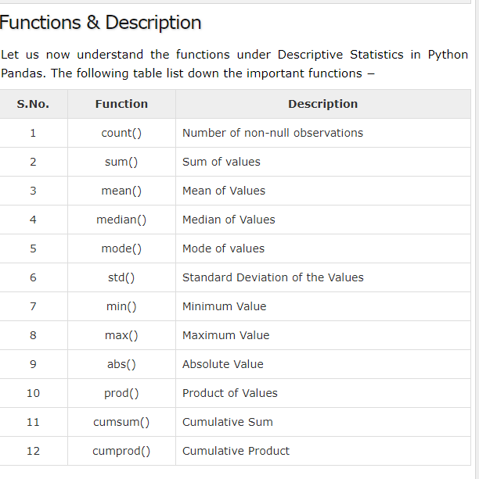

Slide 26
impt
import pandas as pd import numpy as np import matplotlib.pyplot as plt

Slide 27
Basic - data Verification
df = pd.read_csv('C:\\Users\\radha\\Desktop\\weka analysis\\wekadata1.csv') print(type(df)) # Use the `shape` property print(df.shape) # Or use the `len()` function with the `index` property print(len(df.index)) print(df.count()) print(df.head()) print(df.loc[:5,'P_calories']) print(df.iloc[:5,2]) print(df.loc[:5,['P_calories','U_cholesterol']])

Slide 28
Summary stats Output
df2 = df['P_calories'].describe()
pd.options.display.float_format = '{:,.2f}'.format
print(df2)

Slide 29
Scatter Plot
plt.scatter( df['Age'],df['P_calories'], s=30)
plt.xticks(rotation=90)
plt.show()

Slide 30
list2 = [x for x in dfDiSease if x != ' ']
print(list2)

Slide 31
# Covariance print("Covariance") print(df['P_calories'].cov(df['P_Fat'])) print("correlation") print(df['P_calories'].corr(df['P_Protein']))

Slide 32
df3 = df.sort_values('P_calories')
print(df3['P_calories'])

Slide 33
Filter
DfFilter = df[df['P_calories'] < 10000] print(type(DfFilter)) print(DfFilter) print("Covariance") print(DfFilter['P_calories'].cov(DfFilter['P_Fat'])) print("correlation") print(DfFilter['P_calories'].corr(DfFilter['P_Protein']))

Slide 34
plt.hist( DfFilter['P_calories'],50 , density=True, facecolor='g', alpha=0.75) plt.xticks(rotation=90) plt.show()
plt.hist( DfFilter['P_calories'],50 , density=False, facecolor='g', alpha=0.75)

